Slide 1
Food Image Classification for Nutritional Estimation
GROUP P01
Suchi
Priscilla
Alfred
Isabelle
Napatchol
Notes:
Project overview :
Our project is about food Image Classification for Nutritional Estimation,
The dataset used is food101 and we started initial experimentation with the first 10 food clases

Slide 2
Table of Contents
01
Decision Tree
04
InceptionV3
02
Random Forest
05
EfficientNetV2B2
03
CNN
06
Demonstration
Notes:
We implemented different models like …

Slide 3
01
Decision Tree
Notes:
10 classes

Slide 4





Architecture
02
Feature Extraction
Colour Features: Colour histograms binning
Texture Features: LBP and Gabor filters
Shape Features: HOG
04
Classifier Training & Hyperparameter Tuning
DecisionTree Classifier
GridsearchCV used for overfitting and underfitting
Preprocessing
Split First 10 classes (80/20) train – val
Resizing images
e.g., 64x64, 128x128
Normalisation
Feature Selection and Dimensionality Reduction
SelectKbest (f_classif)
RFE
PCA
Performance Evaluation
Accuracy & Loss scores
Classification reports
01
03
05
Notes:
we used the dataset from tensorflow

Slide 5
Iterative Experimentation with Baseline Classification Model (Decision Trees)
Performance
Feature Extraction Experiments | Parameters | Performance | Actions for Model Improvement
Colour Histograms only | Initial model | Val Accuracy = 0.22 Train Accuracy: 0.50 | Testing colour-based features, urgent need for feature selection.
Histogram of Oriented Gradients (HOG) + Colour Histogram | K-Best = 20 RFE = 5 max_depth = 10 | Val Accuracy = 0.20 Train Accuracy = 0.21 Time = 10371.12 sec | Reduced overfitting with efficient dimensionality reduction. Runtime increased dramatically.
HOG + Colour Histogram + Local Binary Patterns (LBP) + Gabor filters | K-Best = 100 RFE = 50 max_depth = 10 | Val Accuracy = 0.20 Train Accuracy = 0.28 Time = 368.65 sec | A high feature vector needs a more aggressive feature selection with Decision Trees.
Final Model HOG + Colour Histogram | PCA =15 max_depth = 5 | Val Accuracy = 0.25 Train Accuracy = 0.22 Time = 988.16 sec | Best feature combination. Runtime balance, Lower overfitting & high validation.
Decision trees are really sensitive to noisy data, making them quite inefficient for our dataset. However, good feature selection techniques improved decision boundaries for better generalisation.
To further improve predictions, we explored ensemble methods (Random Forest), for better accuracy.
Notes:
We tested 10 different feature extraction experimentations and these are some of the unique results
The initial model was tested with color-based features without dimension reduction
1 224 x 224 were for efficient net pre-processing 2 To start the project implementation
We started with Iterative Experimentation with a Baseline Classification Model to evaluate the importance of traditional features
Decision trees really struggle with high-dimensional vectors, the importance of PCA and other techniques for selecting features can't be stressed enough
So for better predictions on the dataset and for further experiments, we explored combining multiple decision trees (ensemble methods)

Slide 6
02
Random Forest

Slide 7
Architecture
We Explored the use of random forests for image classification, testing out different feature extraction techniques to improve performance.
Approach | Methodology | Score
Raw Pixel Training | Images resized (64 * 64), flattened, normalized | 0.3353
Manual Feature extraction | Colour, Texture, shape | 0.31
Feature Extraction with EfficientNet | Used a pre-trained CNN model to extract features. | 0.7647 (best performance)
Notes:
Raw pixel training: where there was no feature extraction done this model

Slide 8
Performance
Random Forest struggled with raw and manually extracted features due to the high visual complexity of food images—leading to poor performance on classes like Apple Pie and Bread Pudding (F1 scores of 0.19 and 0.21)
 | Random Forest with Feature Extraction |  |  | Random Forest with EfficientNet
Food category | Precision | Recall | F1-score | Precision | Recall | F1-score
Beignets | 0.51 | 0.49 | 0.50 | 0.88 | 0.87 | 0.87
Bibimbap | 0.42 | 0.56 | 0.48 | 0.91 | 0.87 | 0.89
Apple_pie | 0.23 | 0.17 | 0.19 | 0.62 | 0.50 | 0.55
Bread_pudding | 0.21 | 0.20 | 0.21 | 0.56 | 0.70 | 0.62

Slide 9
03
CNN

Slide 10
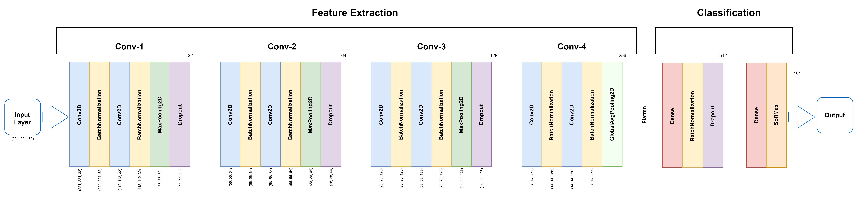
Architecture & Performance
Experiments | Callbacks
Different filters, kernel sizes, layers, optimizers | EarlyStopping
Data Augmentation | ReduceLROnPlateau
Different Batch sizes and epochs
K-fold cross-validation
66%
1,562
Notes:
I will talk about the architecture of the CNN we implemented, and the tests we did to improve its performance.
Our CNN is built in a sequential way.
It starts with input images of size 224 by 224 with three color channels. It uses several convolutional layers with increasing filters—32, 64, 128, then 256 for each convolutional bloc. We also added ReLU activations, batch normalization, pooling, and dropout to reduce overfitting.
In the end, we have two dense layers, and the last one has 101 units with a softmax to classify into 101 food categories.
We trained the model in Google Colab using the Adam optimizer, with callbacks like EarlyStopping and ReduceLROnPlateau to improve training.
We tested different setups: batch sizes, number of epochs, K-Fold validation, data augmentation, different optimizer, different kernel size, different filters, different combination and numbers of layers.
The best accuracy we got on the test set was about 66% and with a loss of 1.56.
Some classes worked very well, others were harder to classify—especially similar-looking foods.
The results suggest the model could still improve, maybe with better augmentation or pre-trained models like EfficientNet or Inception.

Slide 11
04
InceptionV3

Slide 12
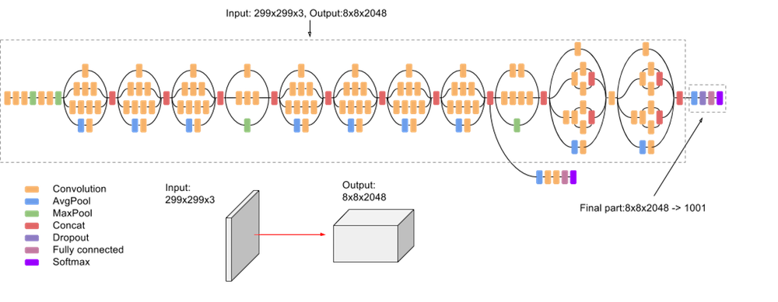
Architecture
Preprocessing: Efficient loading with TensorFlow; images resized and normalised with InceptionV3 preprocessing. Augmentation (flipping, cropping, contrast, brightness, zoom) improves generalisation.
Model: Pre-trained InceptionV3: Global Average Pooling (GAP) layer → Dense (256, ReLU) → Dropout (0.5) → Softmax
Training: Base model frozen initially (Adam, early stopping, scheduling). Fine-tuning: last layers unfrozen (first 200 frozen).
Notes:
InceptionV3 is a deep CNN. Unlike traditional CNNs that apply a single filter size per layer, InceptionV3 uses multiple filters of different sizes at the same time through parallel convolutions. This allows it to capture fine details and larger
patterns more effectively while improving computational efficiency.
From the best experiment, we used data augmentation techniques like flipping, cropping,
contrast, brightness, and zoom adjustments to improve generalisation.
Then we applied it to pre-trained InceptionV3 with a GAP layer, a Dense layer (ReLU
activation), Dropout layer for regularisation, and then a final Softmax layer
Training was done in two phases: initial training with a frozen base model and fine-tuning by
unfreezing the last layers while keeping the first 200 layers frozen to prevent overfitting.

Slide 13
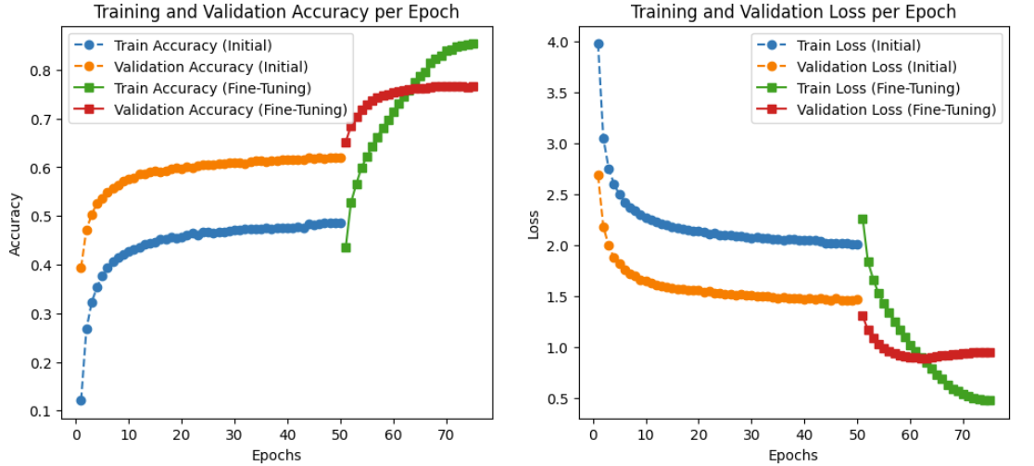
Performance
Runtime Performance:
Trained on Google Colab (A100 GPU)
Total training time: ~4h 20m
Evaluation Metrics:
Test Accuracy: 76.63%
Test Loss: 0.93, reduced by 36% with fine-tuning
Further Improvements:
Advanced data augmentation, attention mechanisms, and hybrid models (CNN-transformers) to enhance feature extraction

Slide 14
05
EfficientNetV2B2
Notes:
For our fifth model, we used EfficientNetV2B2. We chose this variant because it balances training time and accuracy well on the Food101 dataset.

Slide 15
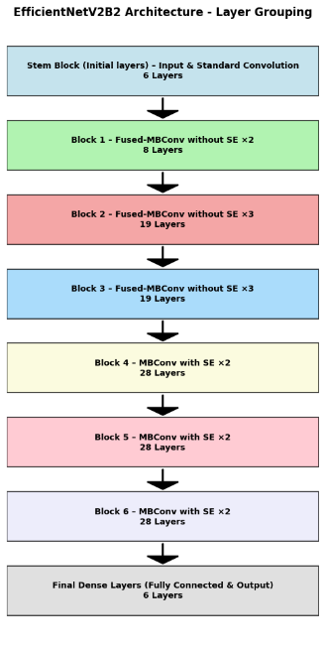
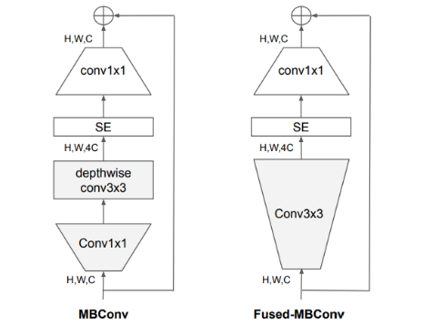
Architecture & Processing
Fully Connected & Output Layers
GlobalAveragePooling2D
Dropout
Activation function:
Relu
softmax
Compile
Loss function: sparse_categorical_crossentropy
Pre-processing input
Resize to 260 by 260
Normalize
Augment
Flipping
Brightness
Contrast
Saturation
Training
Variable
BATCH_SIZE = 128
EPOCHES = 100
Callback function
Early stopping
Learning rate scheduler
Fine-tuning: unfreezing all layers.
MBConv and Fused-MBConv (Tan and Le, 2021)
Notes:
The architecture has 142 layers across six stages, excluding the input and output. The first three stages use fused-MBConv blocks, and the rest use MBConv, which combines depthwise convolution with squeeze-and-excitation for faster and more efficient processing.
In the output layers, we included multiple components, such as GlobalAveragePooling2D, a Dropout layer, ReLU activation, and Softmax activation. When compiling the model, we chose sparse categorical cross-entropy as the loss function.
For the preprocessing of inputs, the images were resized to 260 by 260 pixels. We normalized the images and applied data augmentation techniques, including flipping, brightness, contrast, and saturation adjustment. To improve model training, we also set up early stopping and a learning rate scheduler. We fine-tuned the model by unfreezing all layers to achieve better performance.

Slide 16
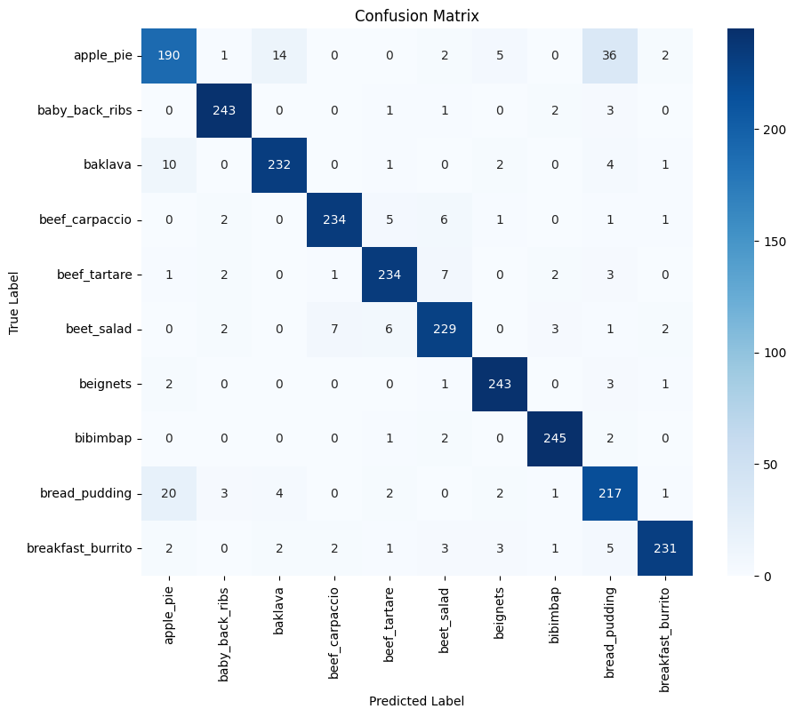
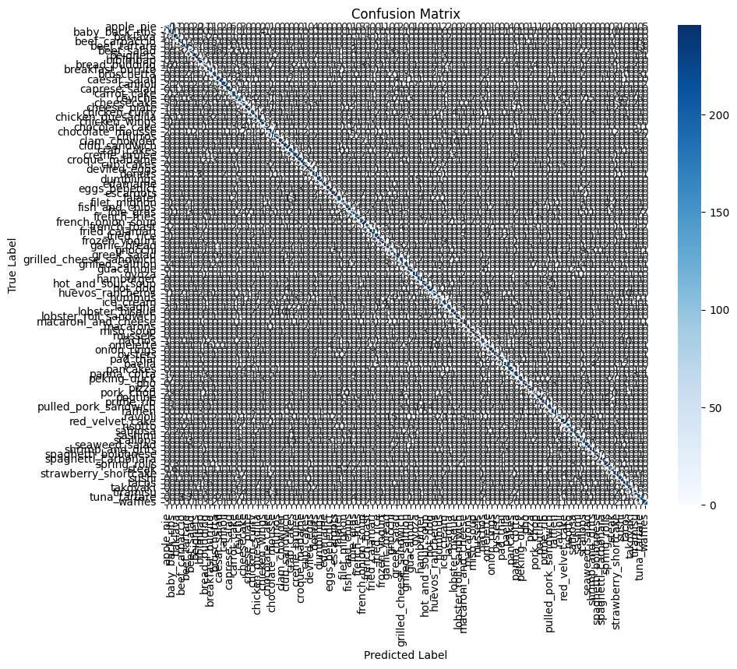
Performance
Runtime Performance:
Trained on Google Colab (A100 GPU)
Total training time: ~4h 53m
Evaluation Metrics:
Test Accuracy: 76.76%
Test Loss: 1.32, reduced by 32.58% with fine-tuning.
Further Improvements:
Apply more augmentation techniques like Zoom, cutout, MixUp, and Blur.
Notes:
Training on Google Colab with an A100 GPU took 4 hours and 53 minutes. We achieved 76.76% test accuracy and reduced test loss by 32.58%.
The confusion matrix shows strong overall performance, even though some classes—like apple pie and bread pudding—were still confused. To improve further, we may add more augmentations, such as Zoom, Cutout, MixUp, and Blur.
Isabelle will now show the demo.

Slide 17
06
Demonstration

